Slide 1


Vehicle CO2 Emissions - EDA
Project 1 ​- Rice University Data Analytics and Visualization Boot Camp​
By William Gray Renton, Isbelis Castro, Gunel Garayeva, Eugenia Chien –Group 06.
Alexander Booth (Instructor)
Reed Schelitzche. – (TA)
June 10th , 2024.
Notes:
All: Hi we are group 6. (Everyone introduces themselves.) We picked the topic of vehicle emissions because being transported by vehicles is a daily occurrence and we are all concerned about pollution to the environment.

Slide 2
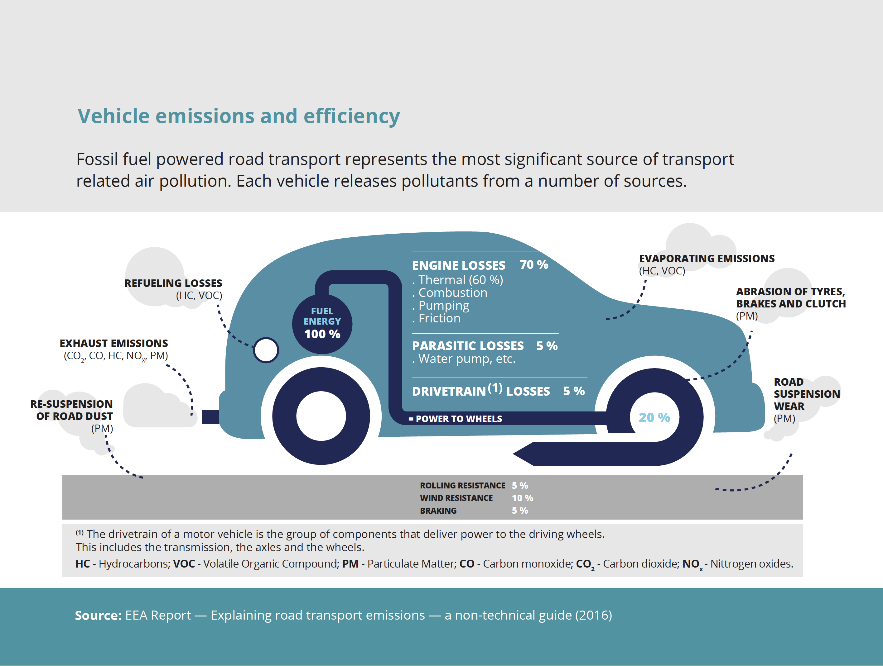
Introduction
CO₂ emission
Grams per kilometer
Fuel
Engine size cm³
Impact
Power of vehicle
Transmission type
Air quality
Notes:
Genie:

Slide 3

Approach
Vehicle Emissions Data Set -used secondary data.
The base date has information about 6,756 records.
Programming language: Python
( panda, numpy, matplotlib, plotly, seaborn, Scipy, sklearn)
Notes:
Genie: We used secondary data from Kaggle.

Slide 4

Data cleaning
Total records before cleaning = 6,756
Data cleaned, with "Electric" filtered out of "transmission_type" column
Final cleaned dataset = 6,542
Notes:
Genie: The dataset consisted of 6,756 cars. During cleaning we noticed that there was a subset that had null for emissions data. Upon further investigation, we found it that those were the Electric cars that did not produce any CO2 emissions. So for the purposes of this project, we used a "drop" function to remove all "Electric" cars from the "transmission_type" column. That removed a little over 200 records and the final dataset consisted of 6,542 records.

Slide 5
Fields list
Item | Field | Description | Type
1 | car_id | Number - A unique identifier for each vehicle | String
2 | manufacturer | Name of manufacturer e.g. "MERCEDES-BENZ", "RENAULT" | String
3 | model | Type of model | String
4 | description | Description of vehicle e.g. "595 1.4 145 BHP" | String
5 | transmission | Gearbox identifier if applicable | String
6 | transmission_type | "Manual", "Automatic", or "Electric - Not Applicable" | String
7 | engine_size_cm3 | Volume of gas displacement in cm³ | number
8 | fuel | Fuel type e.g. "Petrol" "Diesel", etc. | String
9 | powertrain | Vehicle's powertrain e.g. " Internal Combustion Engine (ICE)", "Hybrid Electric Vehicle (HEV)", "Mild Hybrid Electric Vehicle (MHEV)" | String
10 | power_ps | Power of vehicle in PferdStarke (metric measure of horsepower, equivalent to 98.6% of one HP) | Number
11 | co2_emissions_gPERkm | CO₂ emissions (WLTP measurement) in g/km | Number
Notes:
Genie: For our dataset we had 11 fields.

Slide 6
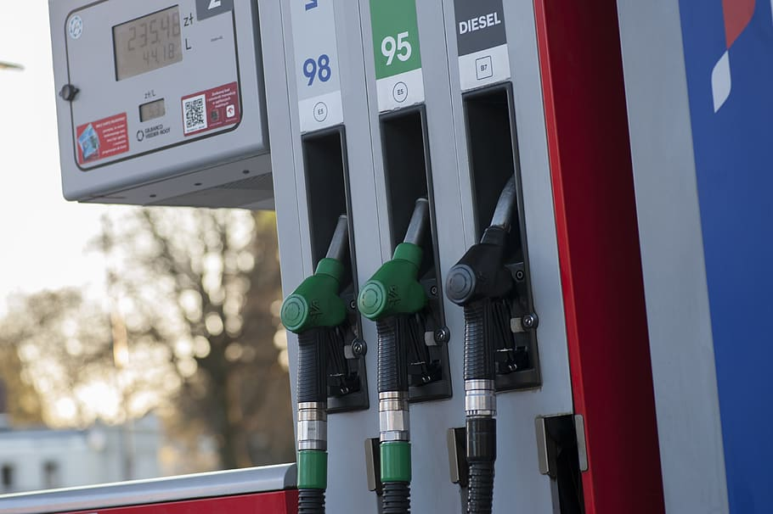
Research question
1
Does the fuel type have an effect on CO₂ emissions?
Hypothesis: ​​
H₀= CO₂ emissions are not affected by fuel type.
​​
H_{(a)}= CO₂ emissions are affected by fuel type.
Notes:
Genie: Research question 1 - does fuel type have an effect on CO2 emissions?

Slide 7
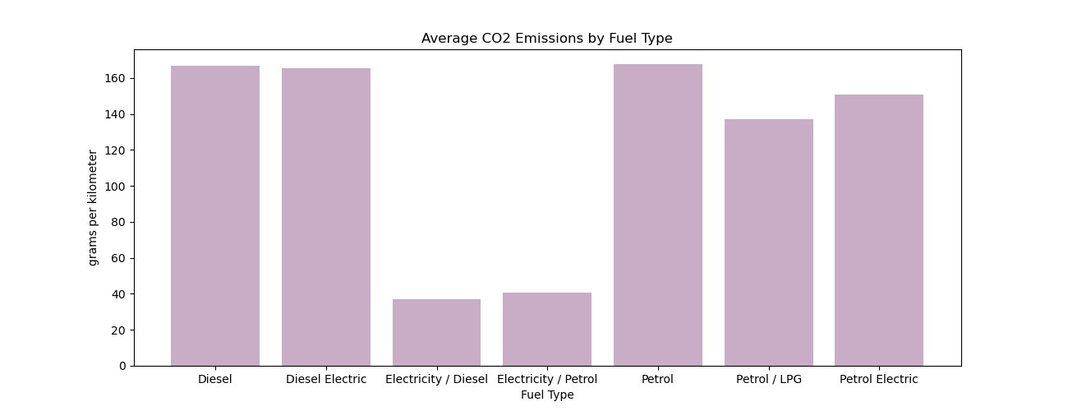
Question 1 - Does the fuel type have an effect on CO₂ emissions?
Notes:
Genie: Petrol, Diesel, and Diesel Electric are the three fuel types that tied for highest CO2 emissions. This is measured by the industry standard of grams per kilometer. The bottom two are Electricity/Diesel, and Electricity/Petrol.

Slide 8
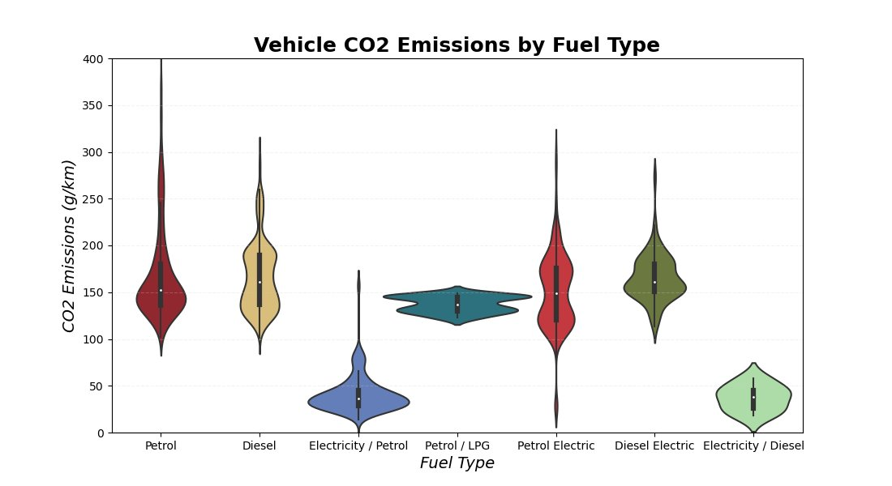
Question 1 - Does the fuel type have an effect on CO₂ emissions?
Notes:
Genie: Here is another look at CO2 emissions by fuel type but this time as a violin chart. This shows us the range and approximate frequency of the data in terms of fuel type. If we go back to the previous slide, using Petrol/LPG as an example, on the bar chart the average CO2 emissions is about 140. Here on the violin chart, we can see that yes, the data ranges from just over 150 to about 120, so the 140 average makes sense. Another insight that we can glean from this is the consistent results that Petrol/LPG and Electricity/Diesel produce. The short and fat shape means there isn't a wide range of data. Compare that with Petrol or Diesel and we can see that the shape is a lot longer and narrower. So based off the consistent results from two graphs, the answer to our question is the alternative hypothesis: "CO2 emissions are affected by fuel type."

Slide 9
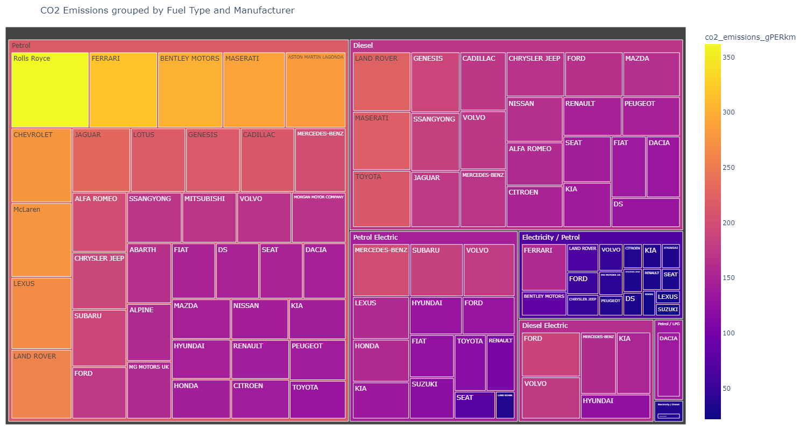
Question 1 - Does the fuel type have an effect on CO₂ emissions?
Notes:
Genie: This is kind of a bonus visualization. I was interested in seeing which manufacturers were producing the vehicles with the most CO2 emissions. This treemap is grouped by Fuel type, Petrol, Diesel, Petrol Electric etc. The color bar on the right tells us the average CO2 emissions with yellow being the highest at 350 and dark blue being the lowest. We can see that most of the Petrol manufacturers are in the higher range with the warmer colors. Majority of the highest CO2 emission manufacturers are luxury car brands.

Slide 10

Research question
2
What is the effect of engine power (PS) on CO2 emissions (g/km)?
Hypothesis: ​​
H₀= CO₂ emissions are not affected by engine power.
​​
H_{(a)}= CO₂ emissions are affected by engine power.
Notes:
Gunel: Research question 2

Slide 11
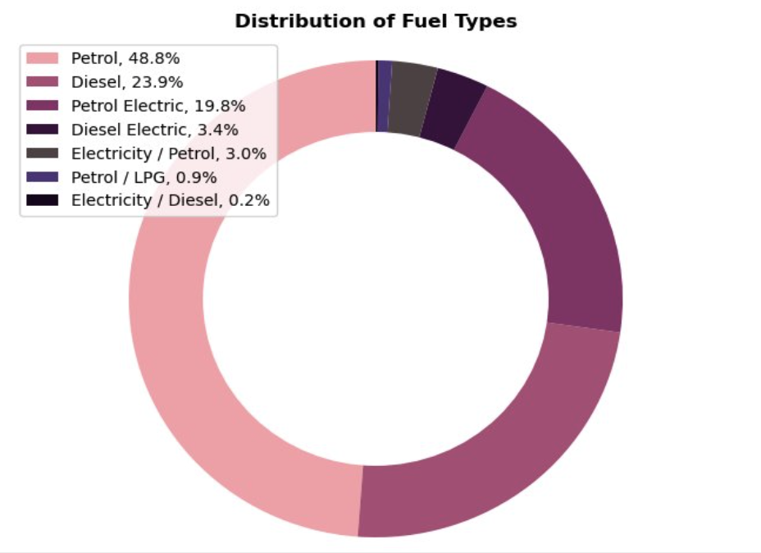
Question 2
The chart highlights the diverse range of fuel types and combinations used in vehicles, with petrol being the most prevalent fuel type followed by diesel and various hybrid options.

Slide 12
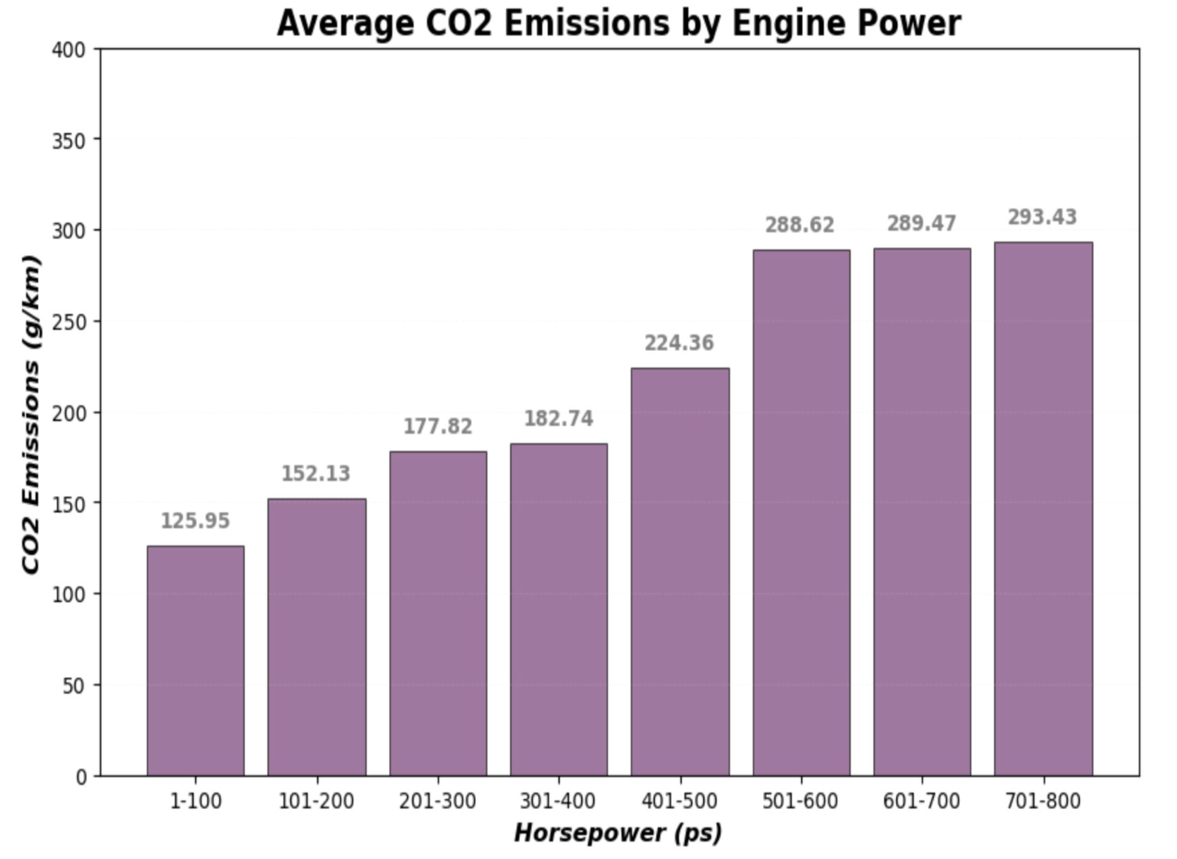
Question 2
The data illustrates a correlation between horsepower and CO2 emissions, with higher horsepower vehicles generally exhibiting increased CO2 emissions. Understanding these trends can inform decisions related to vehicle efficiency and environmental impact.
The highest average CO2 emission of 293.43 g/km is recorded for vehicles with horsepower in the 701-800 ps range.

Slide 13
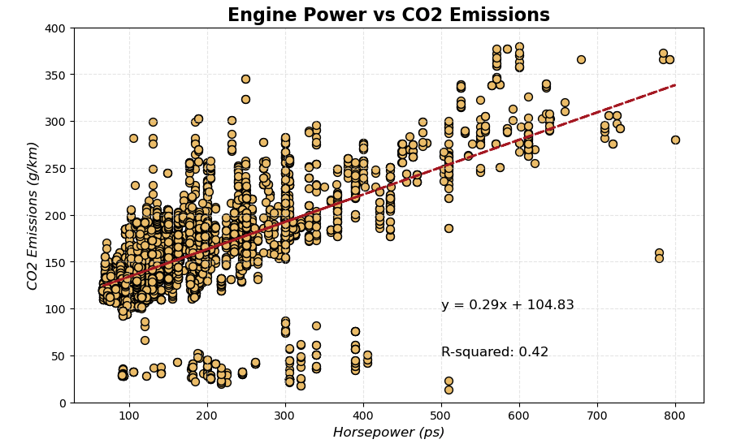
Question 2
There is a correlation between power output and CO2 emissions in vehicles, but it is not a direct one. Other factors also play a crucial role in determining the overall emissions of a vehicle. Manufacturers are continuously working on improving engine efficiency, reducing vehicle weight, and developing alternative powertrains to minimize the environmental impact of their vehicles.

Slide 14


Research question
Does the type of vehicle transmission have effect on CO₂ emissions?
Hypothesis: ​​
H₀= CO₂ emissions are not different depending on the type of vehicle transmission.​​
​​
H_{(a)}= CO₂ emissions are different depending on the type of vehicle transmission.​​
Notes:
Isbelis: Research question 3 - Does the type of vehicle transmission have effect on CO2 emissions?

Slide 15
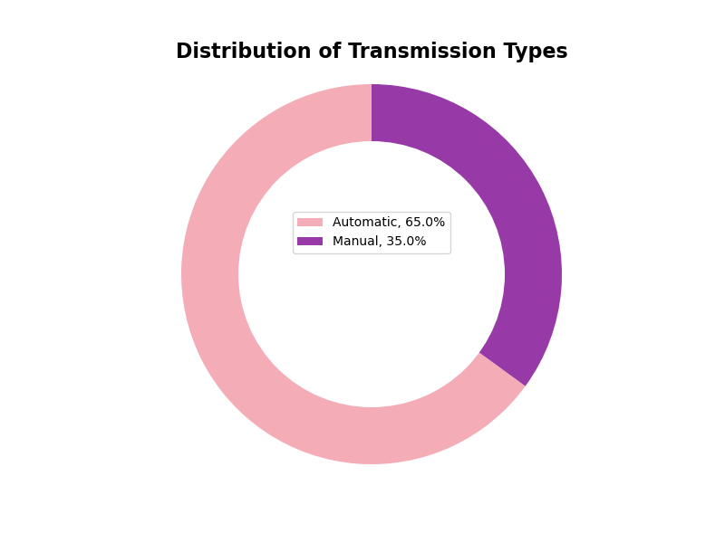
Descriptive
Notes:
Isbelis: The following graph shows that description of the transmission type is remarkable for the concentration on automatic transmission, with more than 60%. It is higher than manual.

Slide 16
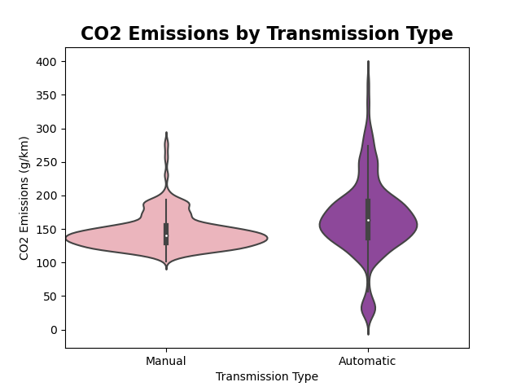


Results and Interpretation
CO₂ emissions for manual and automatic transmission type are not normally distributed.
Mann-Whitney U test:
U statistic=759.0
p-value=0.0064
A highly significant difference in CO₂ emissions between manual and automatic transmissions.
Notes:
Isbelis: The manual transmission presents lower emissions than automatic transmission, and the difference is significant with a p-value less than 0.005. The result is a highly significant difference in CO2 emissions between manual and automatic transmissions

Slide 17
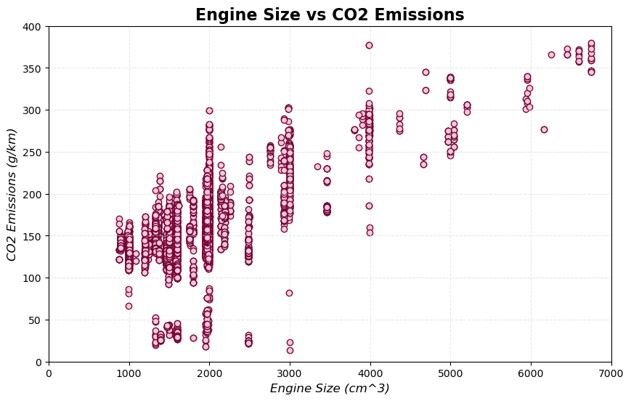
4
Additional Analysis
Prediction time...
Notes:
W: Much like our engine power vs co2 emissions graphic we can make a scatter plot using engine size and see a pretty strong and clear correlation (aside from outliers which consist of hybrid mostly models). With that being said, from this we can do some work to get our best line fit for useful predictions on CO2.

Slide 18
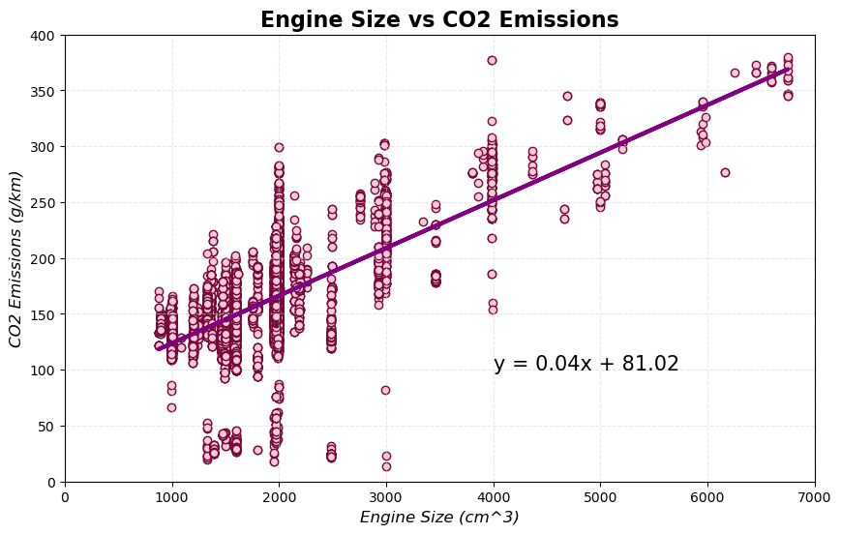
4
R2: 0.472
Linear Regression
Notes:
W: This is the same graphic as the previous slide, but with a beautiful line that allows us to make predictions with an R^2 of 0.472. With this If we had an engine with a size of 3000cm^3 then we can expect co2 emissions of approximately 201.02 g/km.

Slide 19
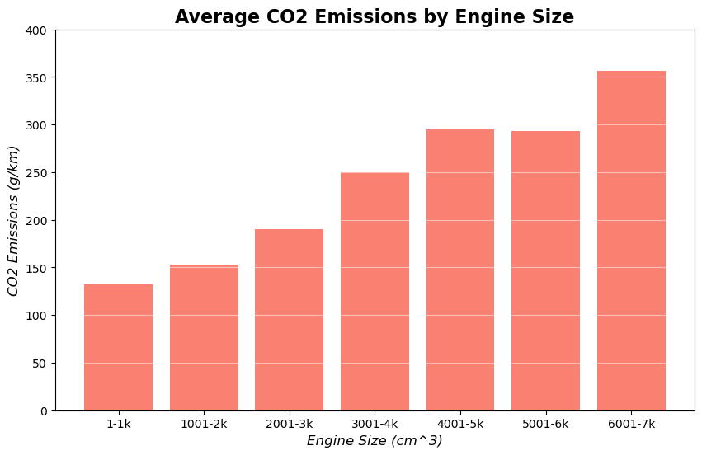
4
Note: Engine sizes are grouped in ranges of 1,000 cm³
Notes:
W: In this graphic I binned each size group in ranges of 1000 cm3. I used the ranges to display the mean/average of co2 emissions within those groups. This Histogram tells a clear story, as our engine size increases our average co2 emissions will also increase.

Slide 20
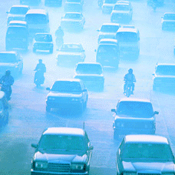
Conclusion
The following factors have a large impact on CO₂ emissions:
Fuel Type
Engine Power
Transmission Type
Engine Size
This Photo by Unknown author is licensed under CC BY.
Notes:
W: in summation properties with the largest impacts on CO2 emissions within the scope of our dataset, consist of Fuel Type, Engine Power, Transmission Type, and Engine Size.

Slide 21
Recommendations
Government
Increase effort and set targets to implement from collaborators to community about impact of CO₂ emissions.
Community
Should receive more education about factors that impact on CO₂ emissions.
Should have more accessibility to efficient transportation according to goals of greenhouse gas emissions.
Further Development
Automatic car computers to mimic results of manual transmission possibly with the help of artificial intelligence or machine learning.
Tax incentives for less CO₂ emissions.
More options for public transportation.
Notes:
Isbelis: which is crucial for environmental considerations, consumer decision-making, and automotive manufacturing

Slide 22

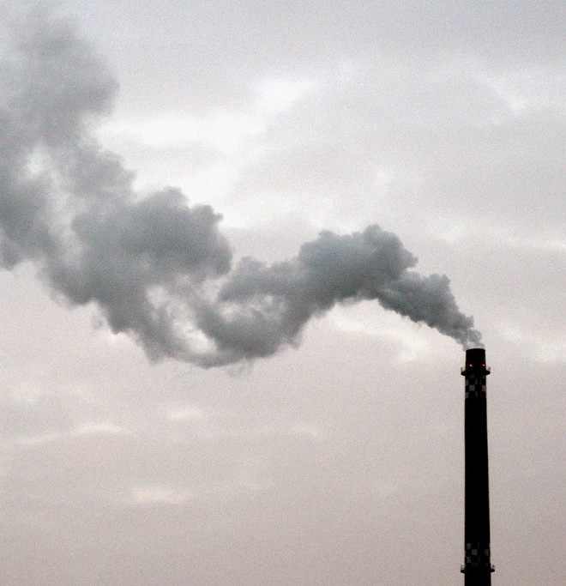
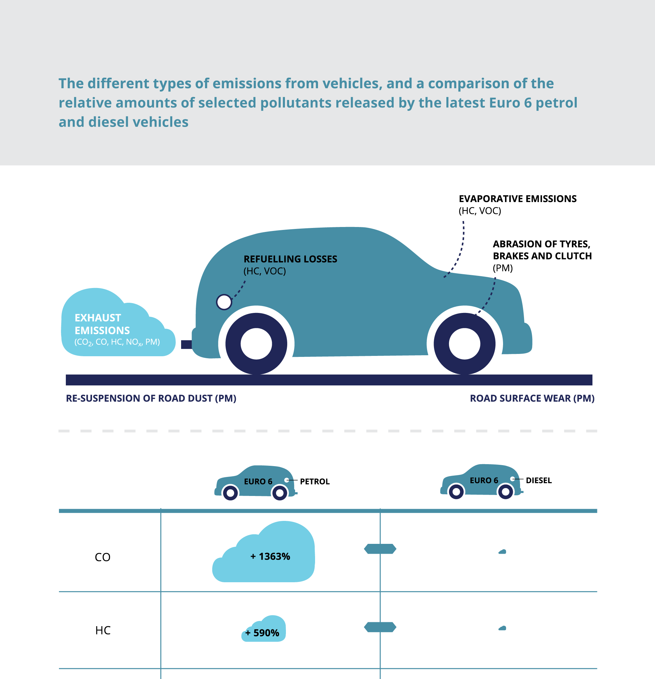
Thank you !

Slide 23

Q&A

Slide 24
References/Work Cited
Raman209. (2023, October 23). Vehicle CO2 emissions prediction. Kaggle. https://www.kaggle.com/code/raman209/vehicle-co2-emissions-prediction
Drfrank. (2021, January 24). CO2 Emission Eda & Visualization & Machine Learnin.Kaggle. https://www.kaggle.com/code/drfrank/co2-emission-eda-visualization-machine-learnin
Karankrishna. (2021, February 20). India Air Quality Analysis. Kaggle. https://www.kaggle.com/code/karankrishna/india-air-quality-analysis
Ashikchandradas. (2024, April 20). CO2 emission Regression Analysis and Visualization. Kaggle. https://www.kaggle.com/code/ashikchandradas/co2-emission-regression-analysis-and-visualization
Accelerating Decarbonization of the U.S. Energy System. (2021). United States: National Academies Press.
U.S. Department of Energy. (2023, January). The U.S. national blueprint for transportation decarbonization. https://www.energy.gov/sites/default/files/2023-01/the-us-national-blueprint-for-transportation-decarbonization.pdf
U.S. Department of Energy. (2023, January). The U.S. national blueprint for transportation decarbonization: Fact sheet. https://www.energy.gov/sites/default/files/2023-01/EERE_TranspoDecarb_factsheet-508_0.pdf
EPA. (2024, June 6). https://www.epa.gov/newsreleases/biden-harris-administration-finalizes-strongest-ever-pollution-standards-cars-position

